Slide 1



CAMPUS
CONNECT
EVENT REGISTRATION SYSTEM
AKHIL ROCK BABU
MAC23MCA-2010
PROJECT GUIDE:
Prof. BIJU SKARIA

Slide 2

INTRODUCTION
CampusConnect - Event Registration System is being developed as a customizable web-based product to streamline event registration and management for educational institutions.
Simplify event management by automating key processes, minimizing manual tasks, and enhancing user experience.
Includes modules for user registration, event creation, approval workflows, dynamic form building, and ticket generation.
Built using PHP, MongoDB, JavaScript, and jQuery, with customization options to meet diverse institutional needs.

Slide 3
EXISTING SYSTEM
Existing event management in educational institutions often relies on manual processes, which are time-consuming and prone to errors.
Current systems lack automation, resulting in inefficiencies in tasks such as participant registration, event tracking, and ticket generation.
Generic or static platforms offer limited customization, making it difficult to adapt to the specific needs of different events or institutions.
Inefficient communication channels lead to delays in approvals, notifications, and updates for organizers and participants.

Slide 4
PROPOSED SYSTEM
Streamlines the entire event registration lifecycle, from organizer approval to participant registration and ticket generation.
Allows institutions to customize the platform’s interface and organizers to create event-specific registration forms using a jQuery form builder.
Sends automated email notifications for approvals, rejections, and event updates, ensuring timely communication.
Provides distinct dashboards and functionalities for admins, organizers, co-organizers, and participants, enhancing user-specific experiences.

Slide 5
LITERATURE REVIEW
>>

Slide 6
Paper 1
Web based College Event Management System and Notification Sender (2022)
Event Management Systems (EMS) have evolved from manual processes to automated web-based solutions for better efficiency, security, and user experience.
Modern EMS utilize MVC architecture, MySQL databases, JSP, and Servlets for modular design, efficient data handling, and dynamic web interactions
Security in EMS is enhanced through barcode-based validation, authentication codes, encryption techniques, and real-time data processing for performance optimization.

Slide 7
Paper 2
Streamlined Application for Managing College Events (2021)
Modern EMS use Flutter for cross-platform front-end development and Python-Django for back-end logic, with Firebase and MySQL ensuring real-time data management.
Security is improved with OTP-based authentication, encrypted data storage, and access control mechanisms to enhance trust and prevent unauthorized access.
Automation features such as real-time notifications, event scheduling, and audience polling enhance user engagement and streamline event operations.

Slide 8
Paper 3
Frictionless and Secure User Authentication in Web-Based Premium Applications (2024)
User authentication is essential for web applications, but traditional methods like passwords are vulnerable to phishing and brute force attacks.
Multi-factor authentication (MFA) integrates OTP verification, biometric data, and cryptographic tokens to strengthen access control.
Frictionless authentication enhances security by using behavior-based profiling, login patterns, device characteristics, and geolocation data.

Slide 9
LIST OF SCENARIOS
6
Website Customization
Admins can customize website interface by choosing preferred font, colour.
Admins can customize background images and banners by uploading the required resources.
Admins can customize Interface texts by filling the details.
User Registration and Login Scenarios
An organizer registers on the platform to create and manage events.
An admin reviews and approves the organizer's account.
Organizers receives email for approval or rejection with reason.
Organizers can now login to start creating and manage events.

Slide 10
LIST OF SCENARIOS
7
Event Management Scenarios
An organizer creates a new event by providing event details (name, date, venue, description, ticket price, etc.).
An organizer uses the jQuery form builder to add specific fields.
An organizer adds co-organizers to assist in managing events.
Registration and Payment Scenarios
A participant views a list of available events.
A participant selects an event and completes the registration process.
A participant uploads required documents for the event during registration.
A participant makes an online payment for the event and receives an event ticket

Slide 11
LIST OF SCENARIOS
8
Ticket Generation and Verification Scenarios
After successful registration and payment, organizers are assigned to approve/reject the registration.
After approval participants receives tickets for the events.
An organizer verifies participant tickets at the event venue for entry verification.
Communication and Feedback Scenarios
A participant provides feedback or reviews on the event after attending.
An admin addresses participant feedbacks and ensures resolution.

Slide 12
BUSINESS RULES
10
Event Registration
Participants must register before the specified deadline.
Multiple event registrations are allowed but require individual completion.
Registrations are processed on a first-come, first-serve basis until capacity is reached.
Event Payment
Payments must be made within the designated window.
Payment confirmation is required for ticket issuance or access to event materials.

Slide 13
BUSINESS RULES
11
Ticketing and Entry
Each participant receives a ticket for event access.
Entry is denied without valid tickets.
Event Updates and Notifications
Event approval/rejection updates are communicated via email through the platform.
Admin Approval
Organizers require institutional admin approval to create and manage events.

Slide 14
MODULE DESCRIPTION
Organizer Management Module:
Organizers can self-register on the platform with necessary details.
Organizers' registrations are subject to approval by institutional admins. Once approved, they can access event creation and management features.
Login credentials are generated during registration, and organizers can login using that credentials.
Organizers can then add Co-organizers for collaboration.

Slide 15
MODULE DESCRIPTION
Event Management Module:
Approved Organizers can create, and manage event details, including schedules, categories, and venue information.
Utilizes the Dynamic Form Builder to create customized registration forms for specific events.
Enables event organizers to manage participant registrations.
Enables organizers to send updates to participants registered for events via email.

Slide 16
MODULE DESCRIPTION
Participants Management Module:
Participants can register for single or multiple events via an user friendly interface.
Participants are notified about event-related updates in real time.
Organizers can monitor and manage participant registrations and track registration statuses.
Participants can view fee details and make secure online payments through integrated payment methods

Slide 17
MODULE DESCRIPTION
Customization Module:
Institutional Admins can customize the platform interface to align with their branding and functional needs
update font
update images & banners
update colour schema
update text
Feedback Management Module:
Participants can provide feedback about events, services, or issues encountered.
Admins can view these feedbacks for service improvement.

Slide 18
TECHNICAL FEASABILITY
20
Reliable and Accessible Technologies: Utilizes HTML, CSS, JavaScript, and jQuery for an interactive and responsive frontend interface.
Efficient Backend and Database: PHP handles server-side processes, while MongoDB ensures flexible and scalable data management for diverse event data and user profiles.

Slide 19
ECONOMIC FEASABILITY
21
Cost-Effective Technologies: Leverages open-source tools like HTML, CSS, JavaScript, PHP, and MongoDB, eliminating licensing fees and reducing development costs.
Lower Operational Costs: Automates tasks like registration, payment tracking, and communications, minimizing manual effort and human error.
Long-Term Savings: While hosting and maintenance incur expenses, these are outweighed by efficiency gains, reduced administrative workload, and improved user experience.

Slide 20
OPERATIONAL FEASABILITY
22
Efficient Backend Processing: PHP manages user authentication, event scheduling, and registration, while MongoDB ensures scalable and flexible data storage.
Modular and Scalable Design: The system's modular architecture simplifies updates and maintenance, reducing downtime and adapting to evolving institutional needs.
Enhanced Productivity: Automates routine tasks, ensures accurate data handling, and reduces administrative overhead, with periodic updates and security patches ensuring long-term success.

Slide 21
ORGANIZERS
2
ACTORS
ADMIN
PARTICIPANTS
1
3
4
CO-ORGANIZERS

Slide 22
TECHNOLOGY
 | FRONT END | BACK END
 | DATABASE | ENVIROMENT
 |  | mop
HTML
CSS
JavaScript
JQuery Form Builder
(for creating dynamic registration forms)
PHP
MongoDB
JSON format
(for storing form fields as key-value pairs)
XAMP

Slide 23





ROLES & RESPONSIBILITIES
ADMIN
User Management
Approve/Reject Organizers
Customization
customize website interface such as images, logos, branding elements and texts that aligns for specific institutions and events
Registration Management
Access and manage participant registrations for all events.
Monitor registration trends.
Event Management
View event details and participant statistics.
Feedback Management
View Feedbacks to improve the system submitted by participants.

Slide 24


ROLES & RESPONSIBILITIES
ORGANIZERS
Event Creation and Management
Create and manage events, including adding event details, dates, and venues.
Customize registration forms for each event.
Participant Management
View participant details for their events.
Track participant status (approved, rejected or pending).
Co-Organizer Management
Add co-organizers for each event for better collaboration.
Registration Management
Track registration stats
Organizers can export the list of registrations as pdf for offline use
Payment and ticket generation
Add Payment Qr-codes
Generate and manage discount codes.

Slide 25




ROLES & RESPONSIBILITIES
PARTICIPANTS
Ticket Management
Download or receive tickets after successful registration.
Access event tickets for entry.
Event Registration
Search for events and register using dynamic forms tailored to event needs.
Registration Management
Track registration status of events registered (whether approved by organizers)
FeedBack
Submit Feedback form about the experience using the system.

Slide 26
UML DIAGRAMS
>>

Slide 27
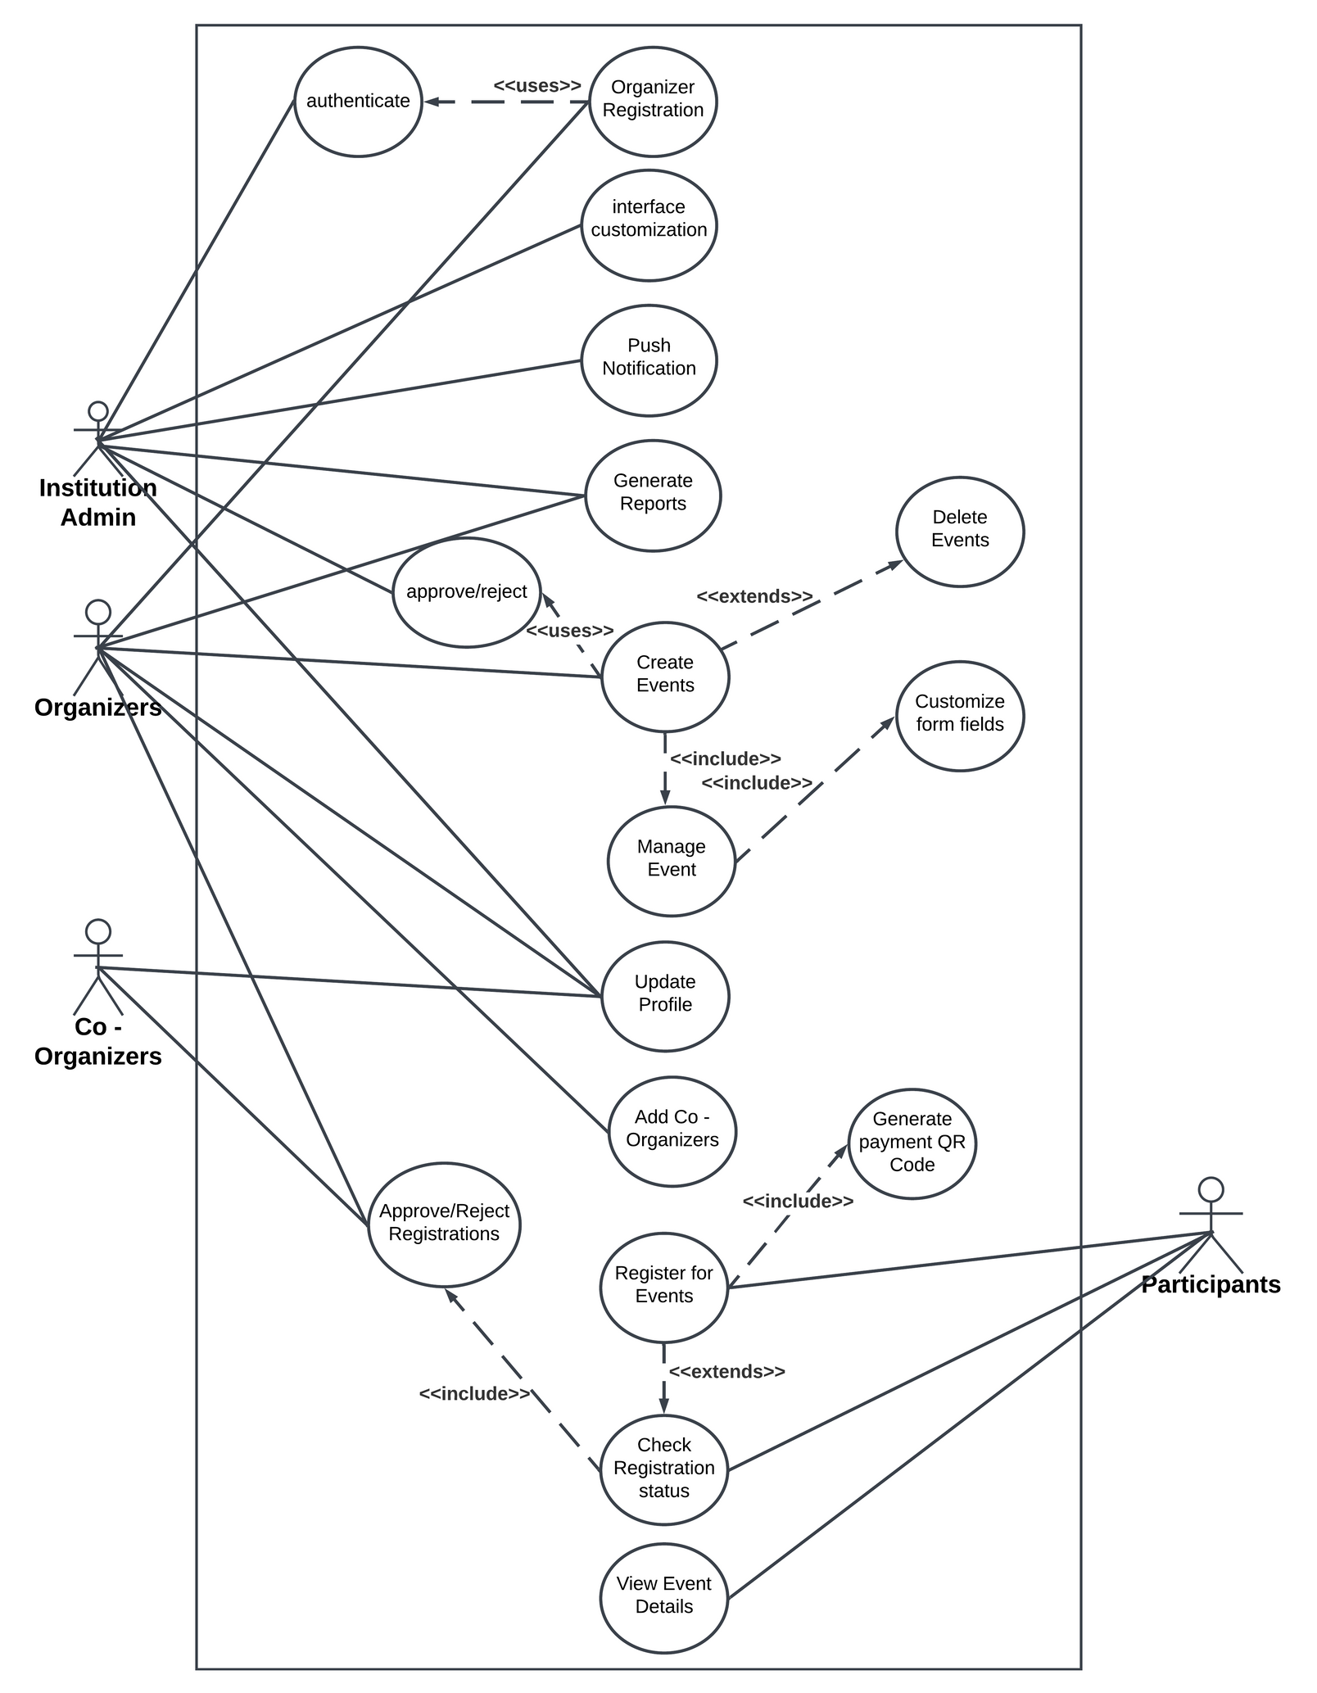
USE CASE DIAGRAM

Slide 28
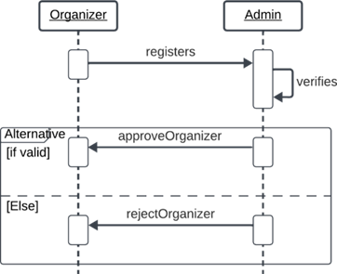
SEQUENCE DIAGRAM
ORGANIZER REGISTRATION

Slide 29
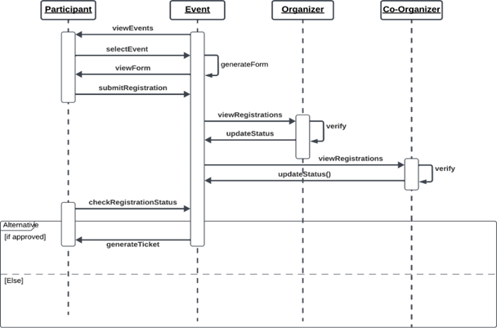
SEQUENCE DIAGRAM
PARTICIPANT EVENT REGISTRATION

Slide 30
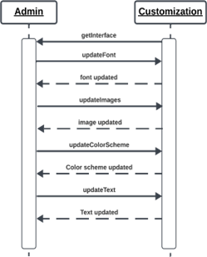
SEQUENCE DIAGRAM
INTERFACE CUSTOMIZATION

Slide 31
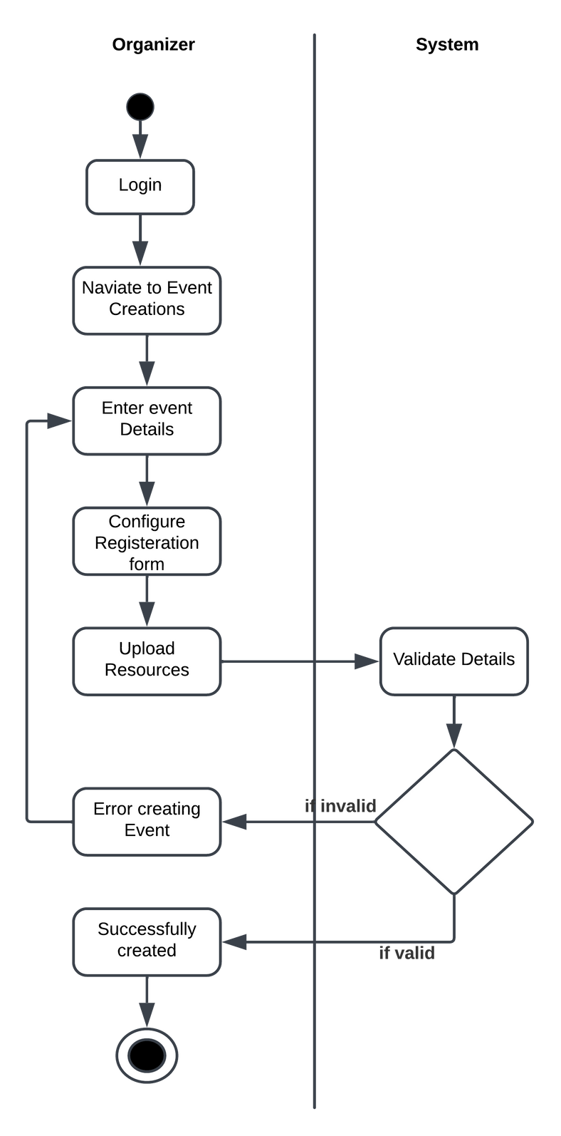
ACTIVITY DIAGRAM
EVENT CREATION

Slide 32
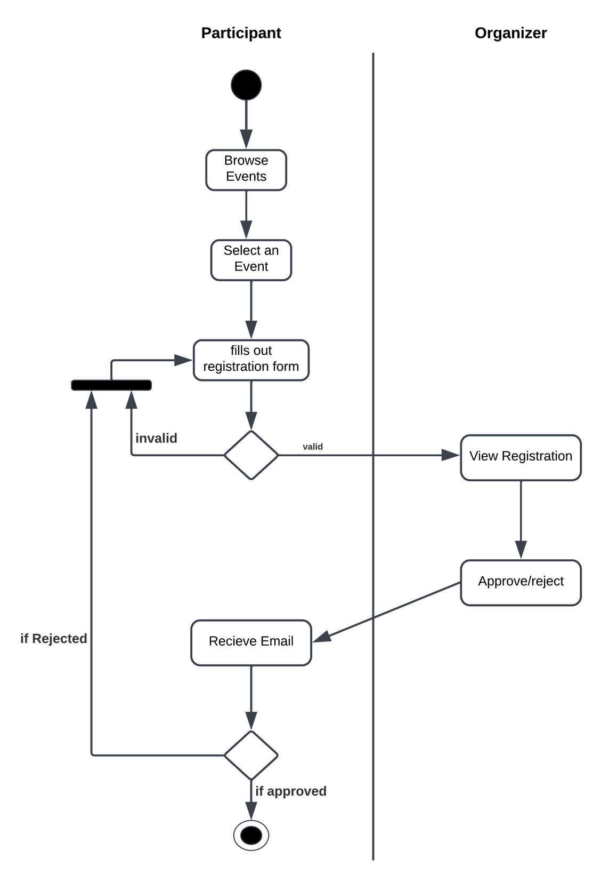
ACTIVITY DIAGRAM
PARTICIPANT EVENT REGISTRATION

Slide 33
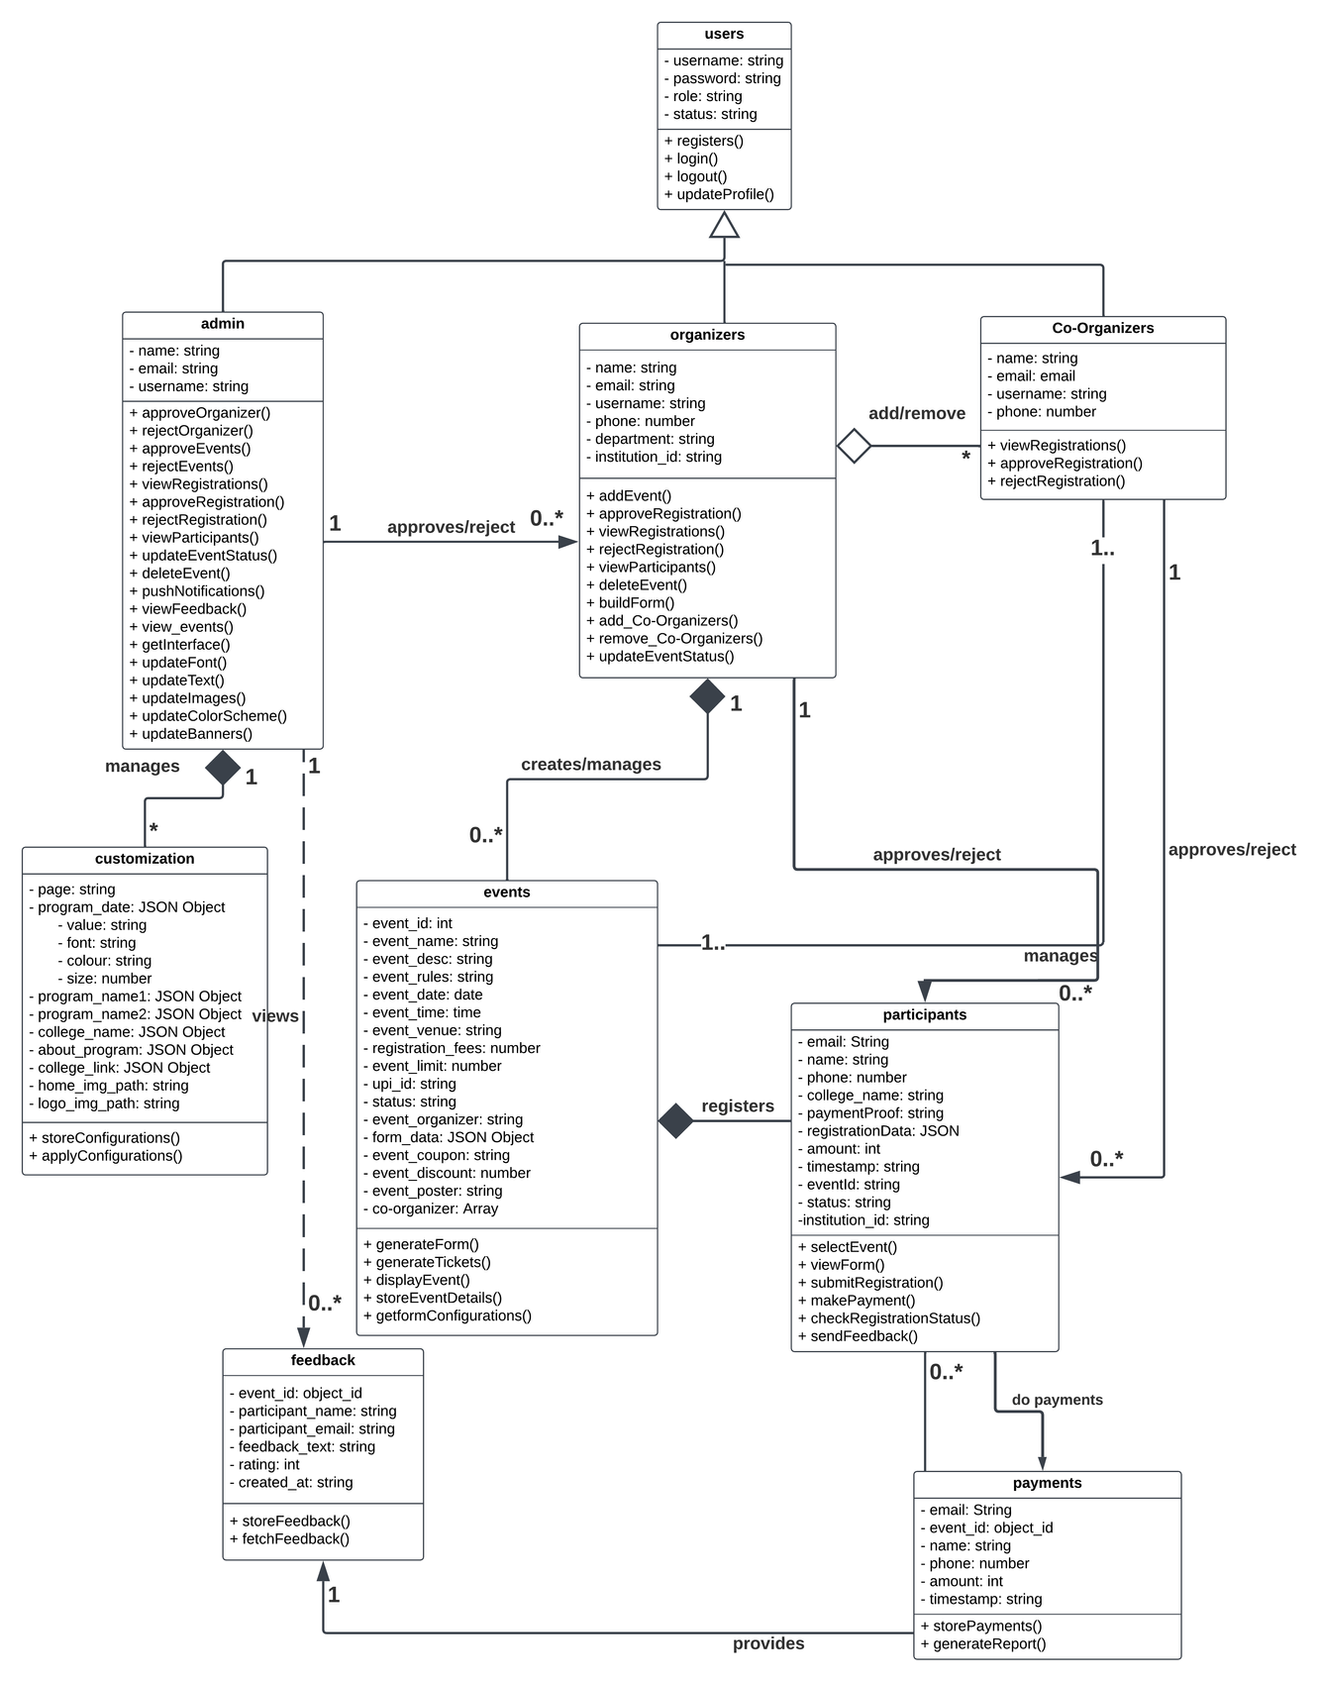
CLASS DIAGRAM

Slide 34
DATABASE
DESIGN
>>

Slide 35
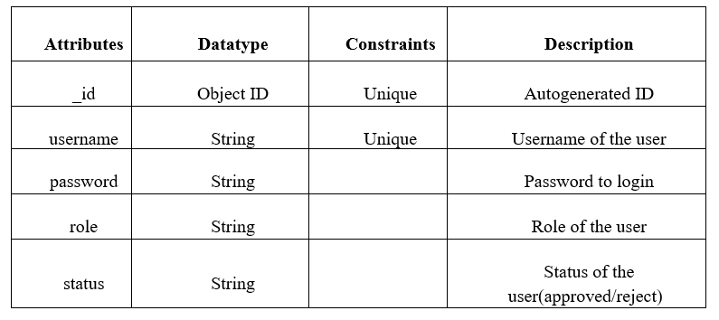
USERS

Slide 36
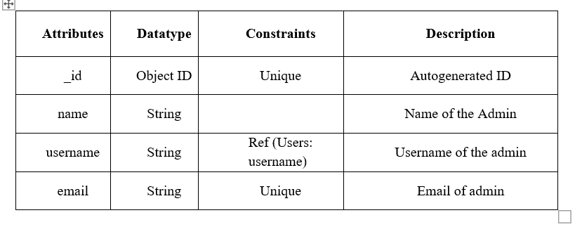
ADMIN

Slide 37
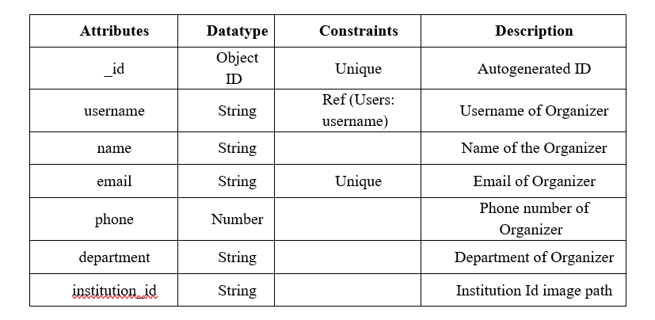
ORGANIZERS

Slide 38
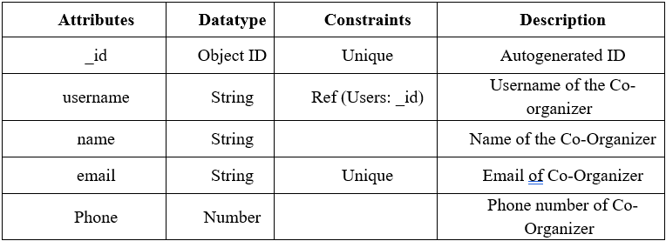
CO - ORGANIZERS

Slide 39
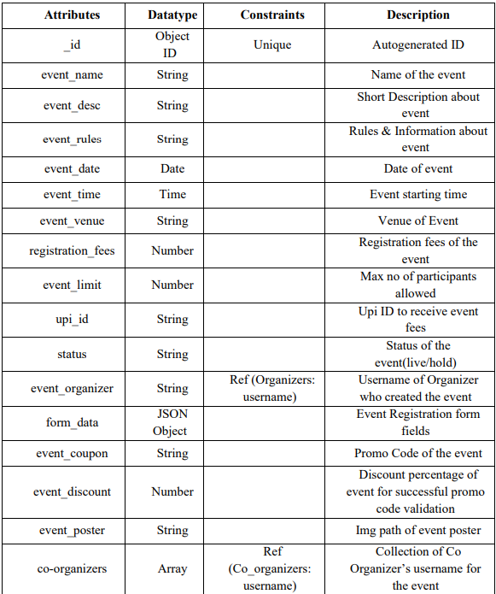
EVENTS

Slide 40
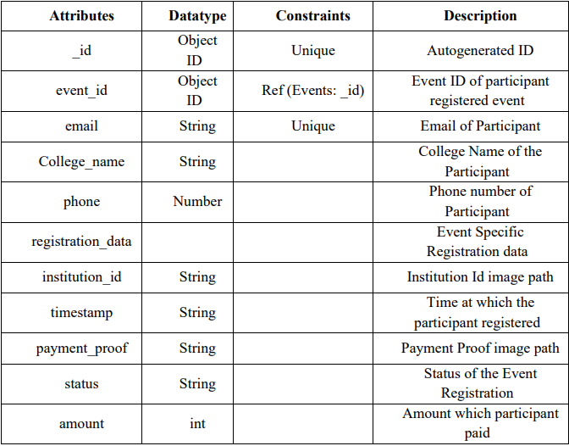
PARTICIPANTS

Slide 41
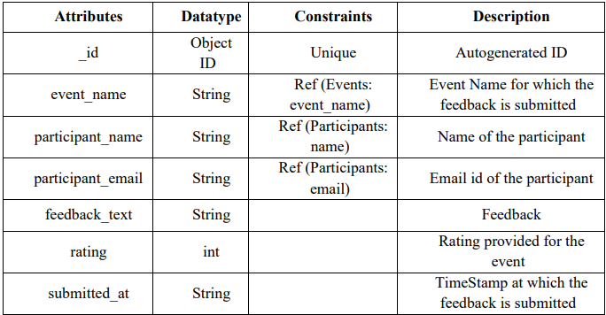
FEEDBACKS

Slide 42
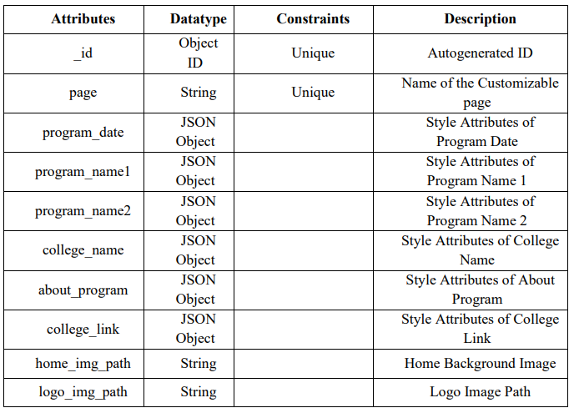
CUSTOMIZATION

Slide 43
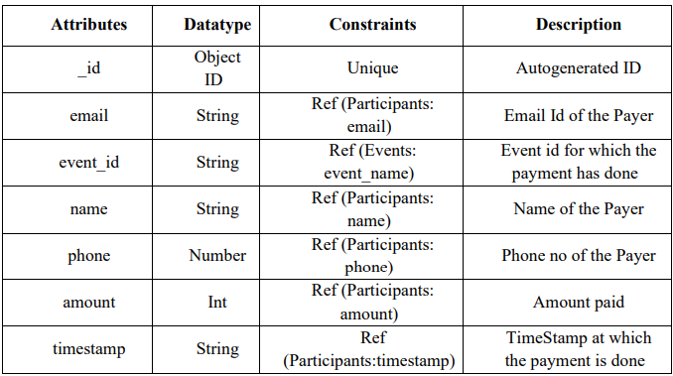
PAYMENTS

Slide 44
UI
DESIGNS
>>

Slide 45
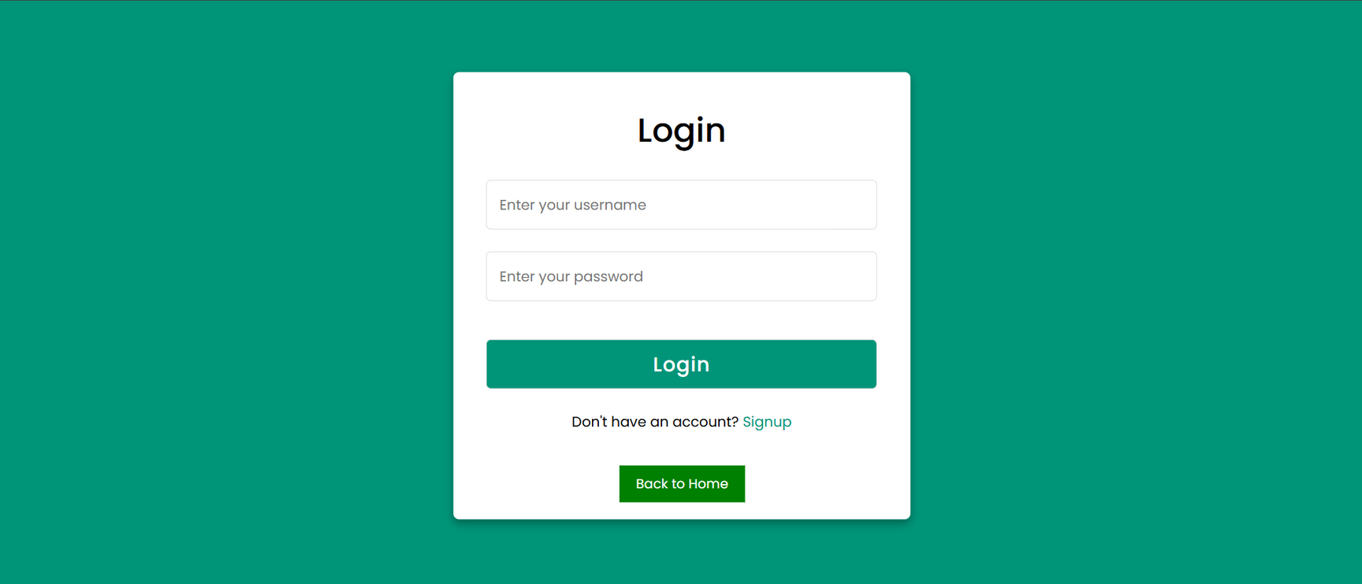
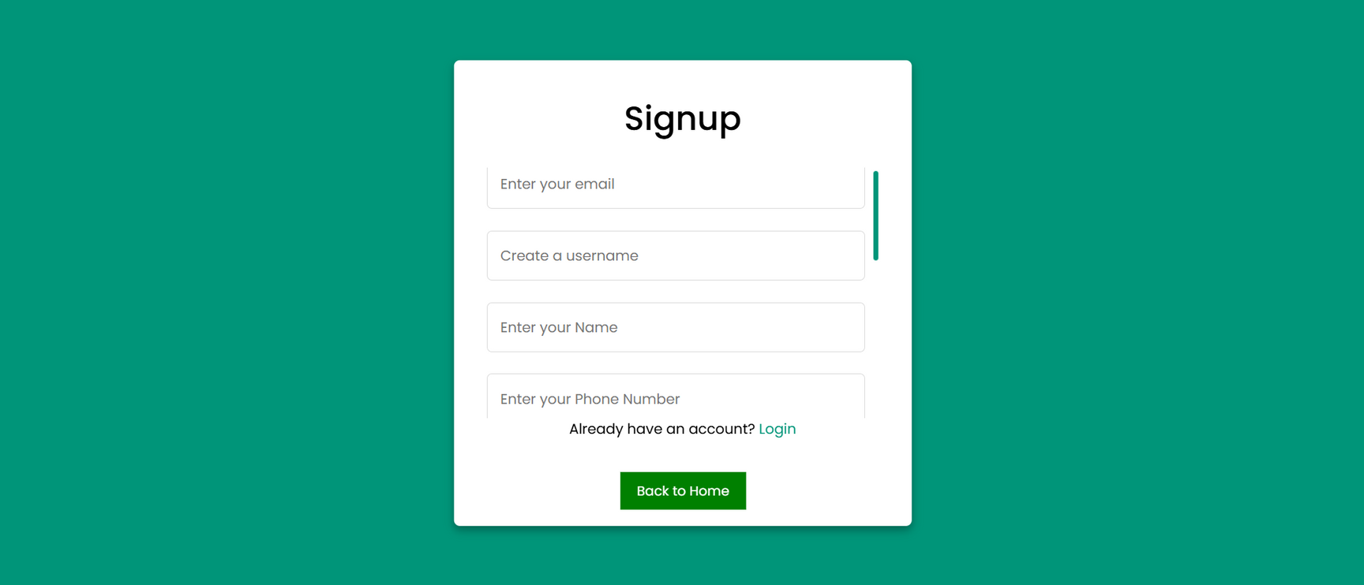

LOGIN/REGISTRATION

Slide 46
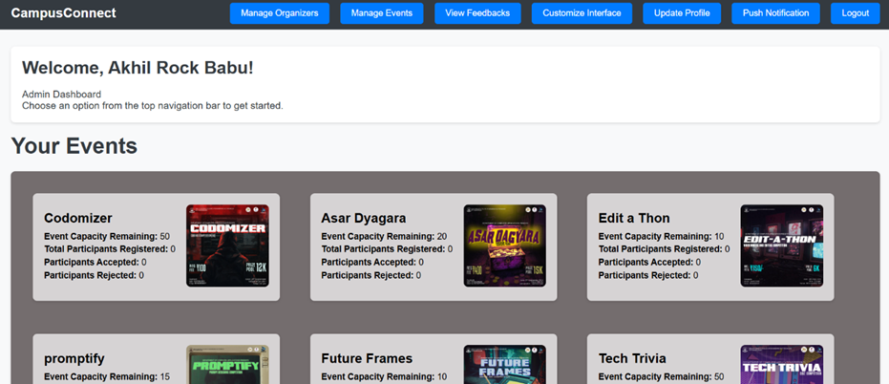
ADMIN DASHBOARD

Slide 47
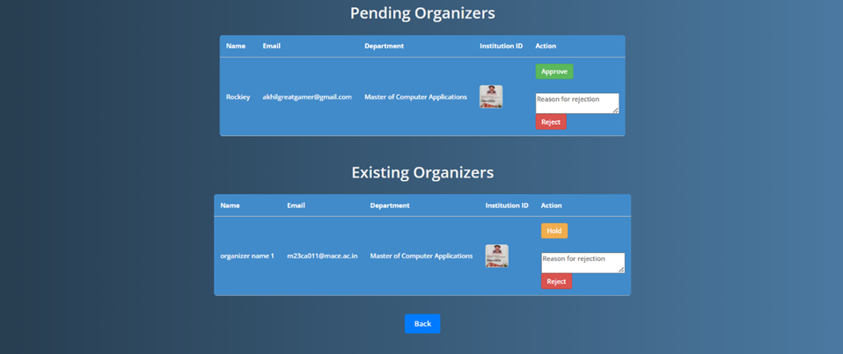
ORGANIZER MANAGEMENT

Slide 48
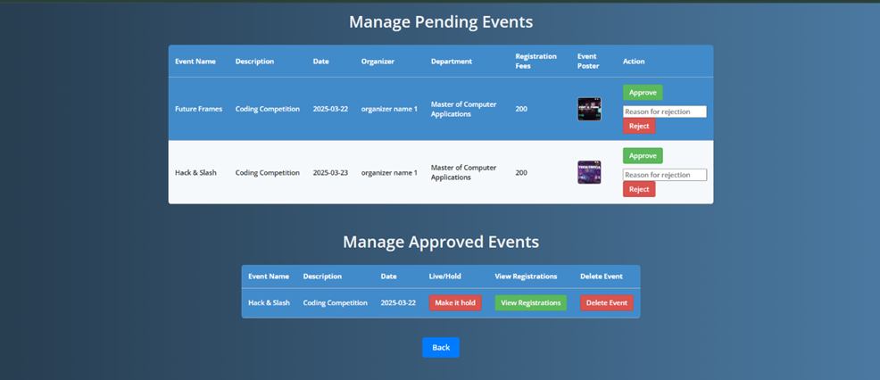
EVENT MANAGEMENT

Slide 49
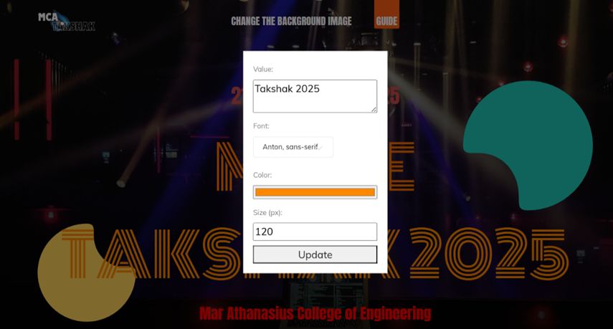
CUSTOMIZATION

Slide 50
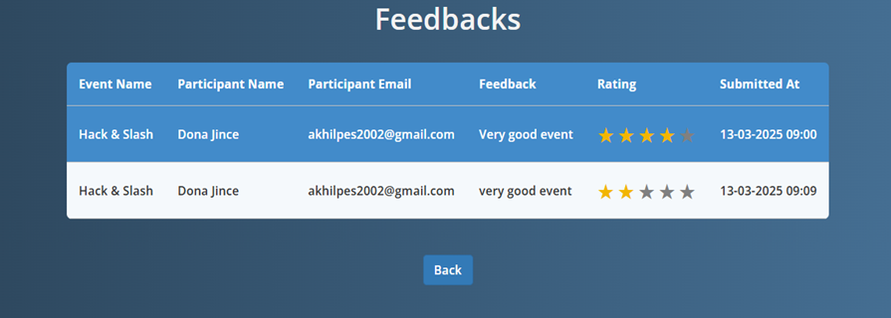
VIEW FEEDBACK

Slide 51
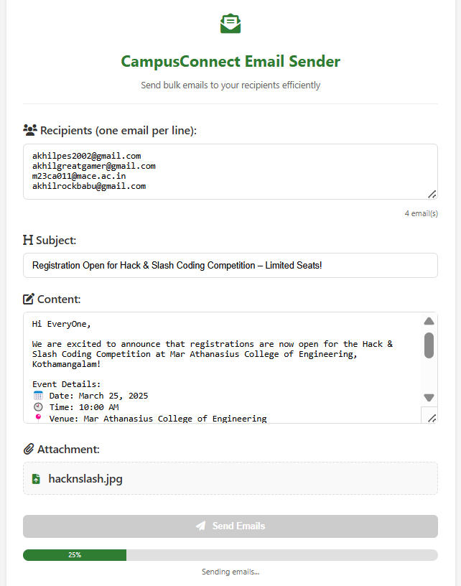
PUSH
NOTIFICATION

Slide 52
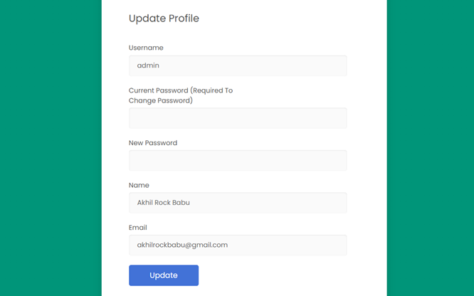
PROFILE MANAGEMENT

Slide 53
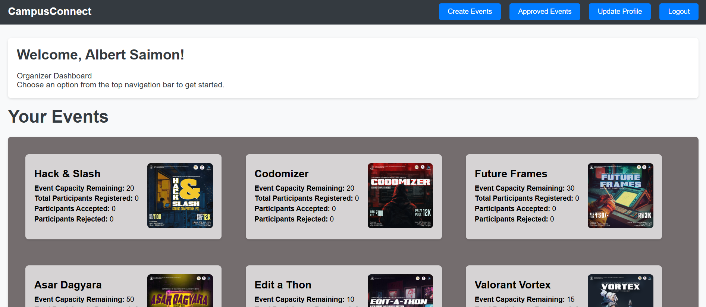
ORGANIZER DASHBOARD

Slide 54
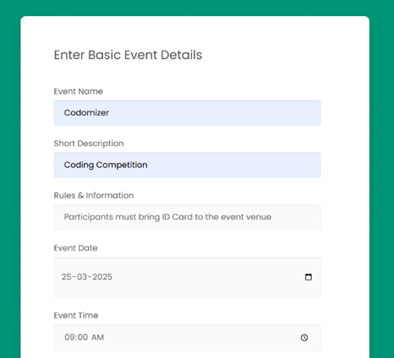
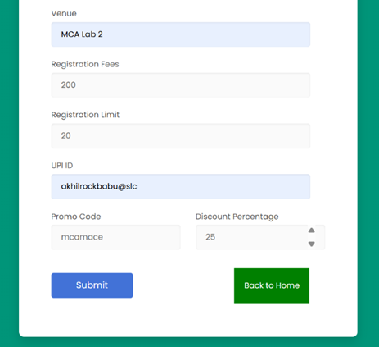
EVENT CREATION BASIC FORM

Slide 55
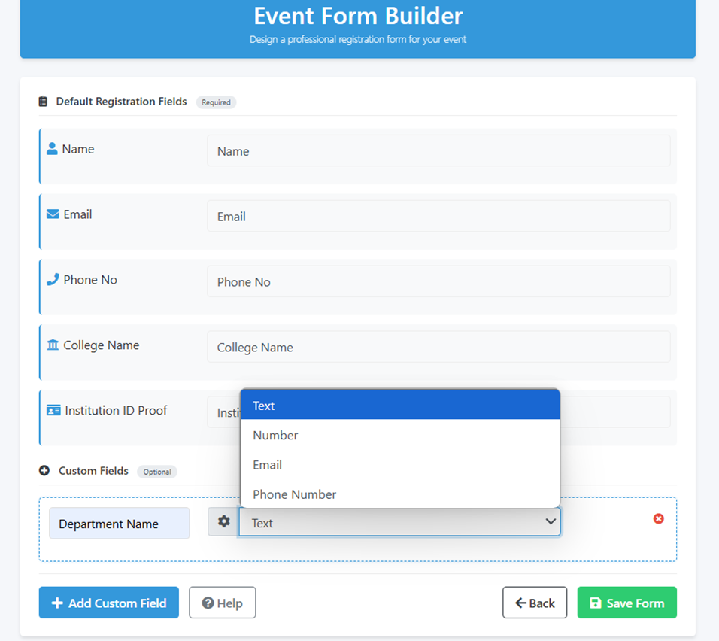
EVENT CREATION FORM BUILDER

Slide 56
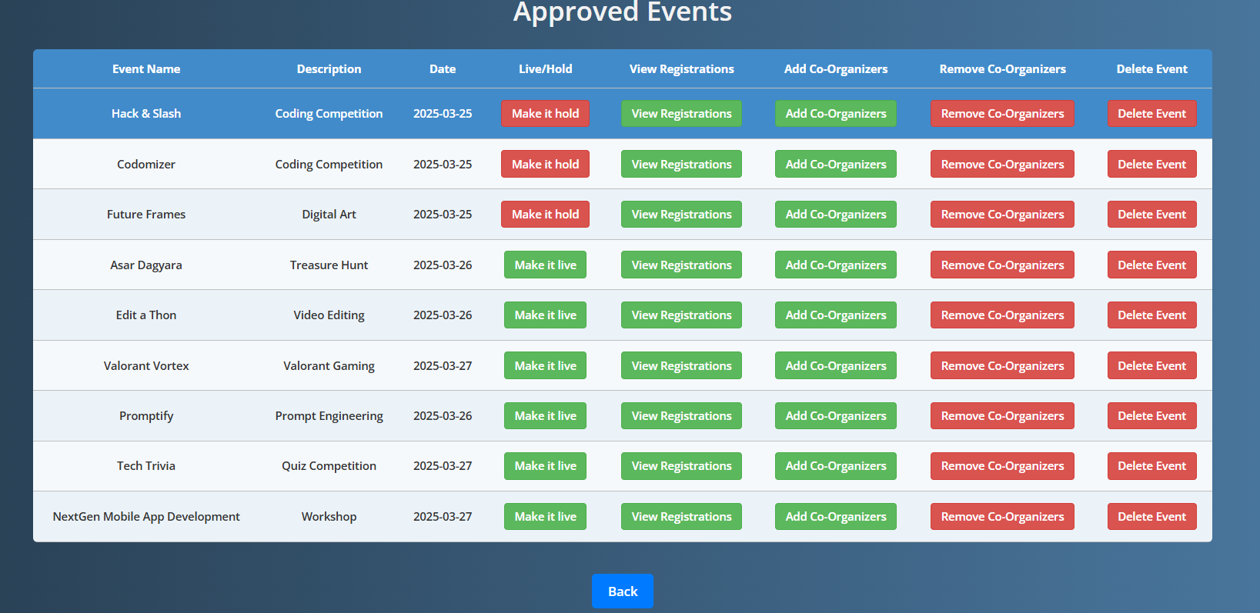
ORGANIZER EVENT MANAGEMENT

Slide 57
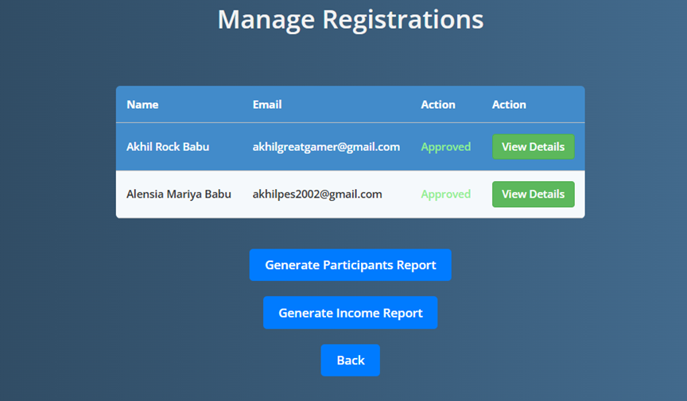
EVENT REGISTRATIONS MANAGEMENT

Slide 58
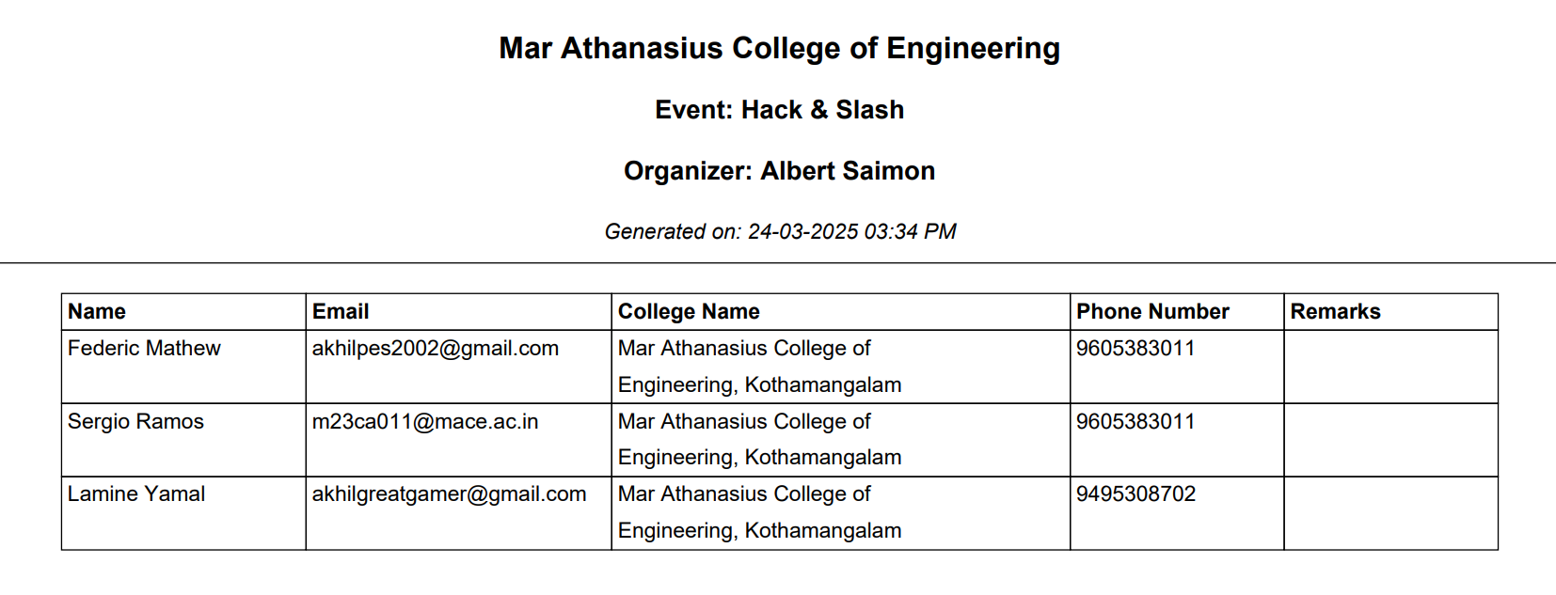
GENERATED REGISTRATIONS PDF

Slide 59
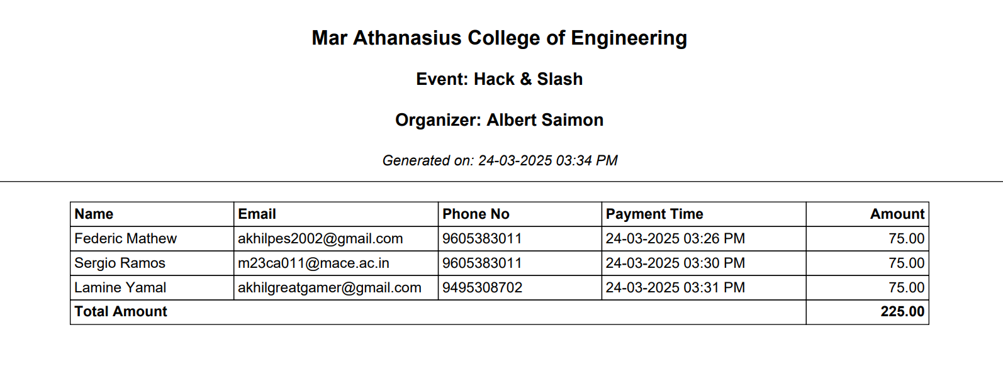
INCOME REPORT PDF

Slide 60
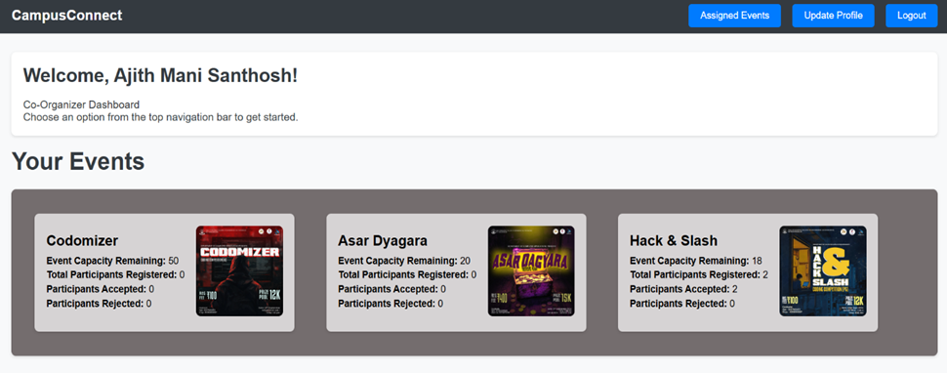
CO-ORGANIZERS DASHBOARD

Slide 61
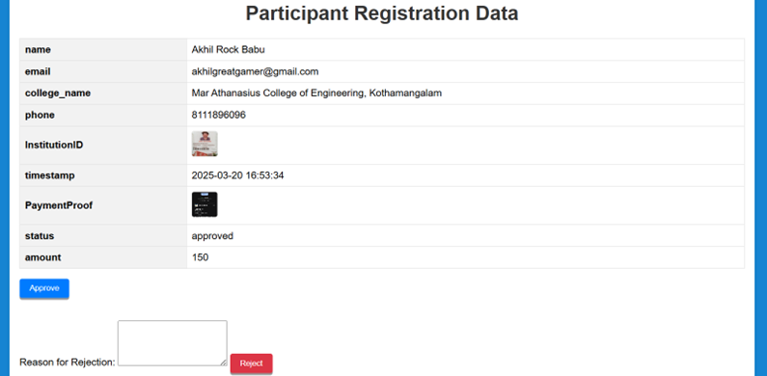
VIEW REGISTRATION DATA

Slide 62
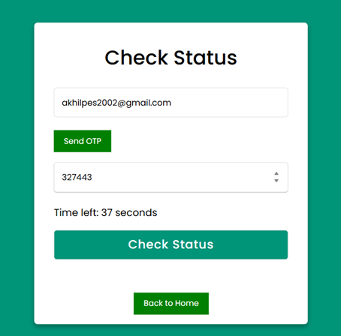
CHECK STATUS

Slide 63
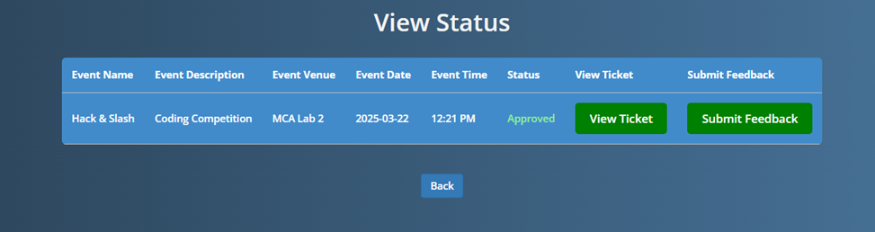
VIEW STATUS

Slide 64


TICKET GENERATION

Slide 65
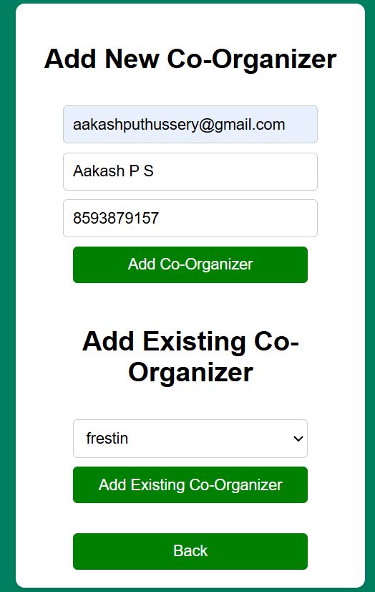
ADD CO-ORGANIZERS

Slide 66
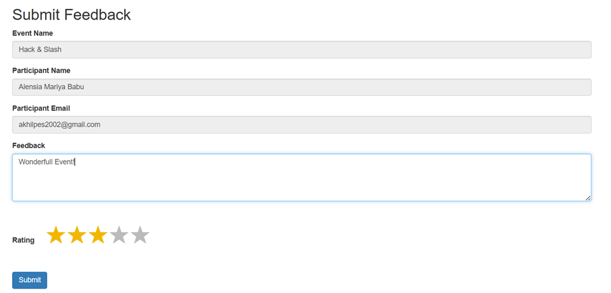
FEEDBACK FORM

Slide 67
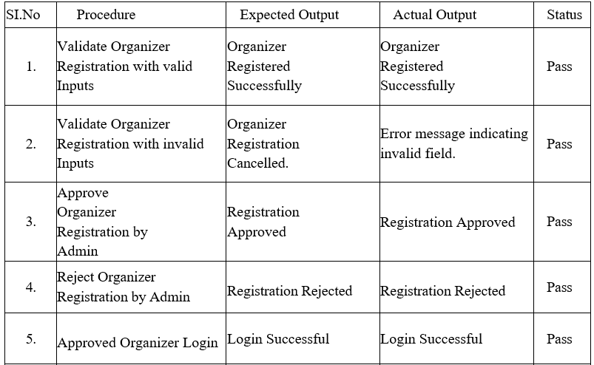
UNIT TEST CASES

Slide 68
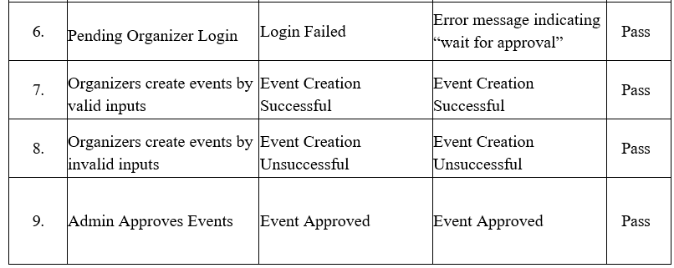
UNIT TEST CASES

Slide 69
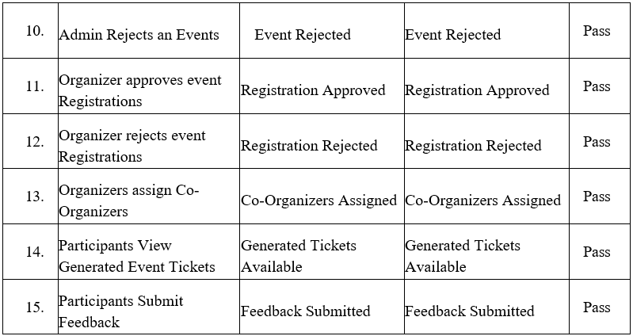
UNIT TEST CASES

Slide 70
UNIT TEST CASES

Slide 71
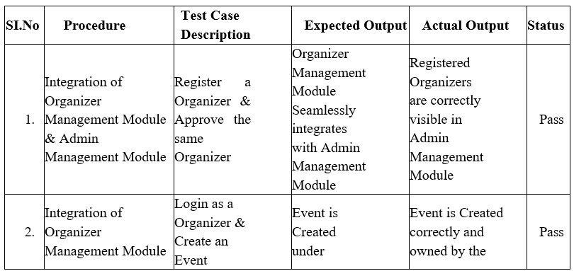
INTEGRATION TEST CASES

Slide 72
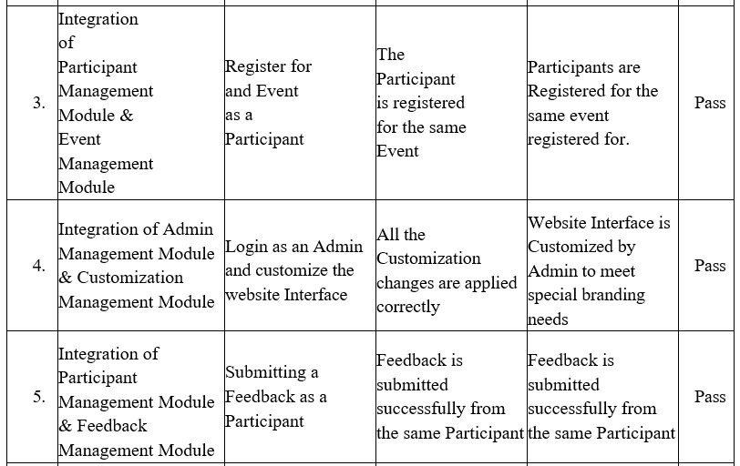
INTEGRATION TEST CASES

Slide 73
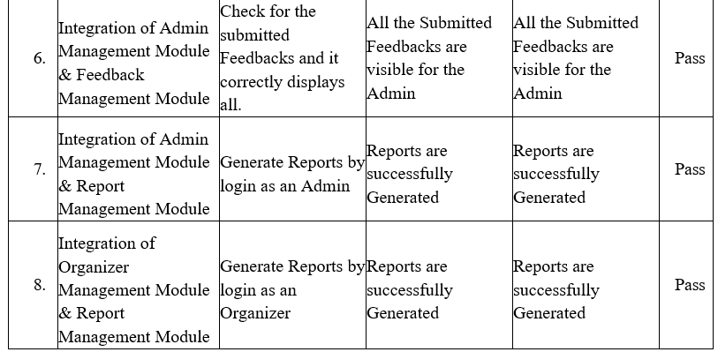
INTEGRATION TEST CASES

Slide 74
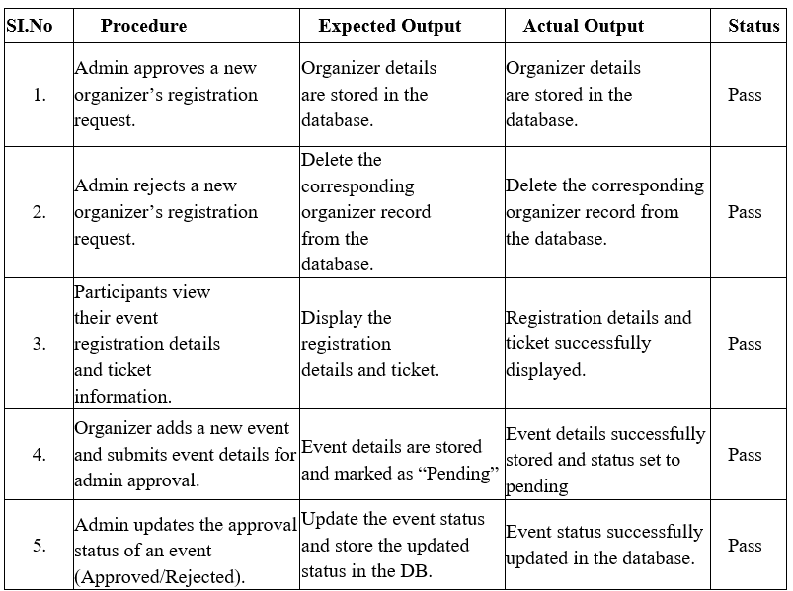
BACKEND TEST CASES

Slide 75
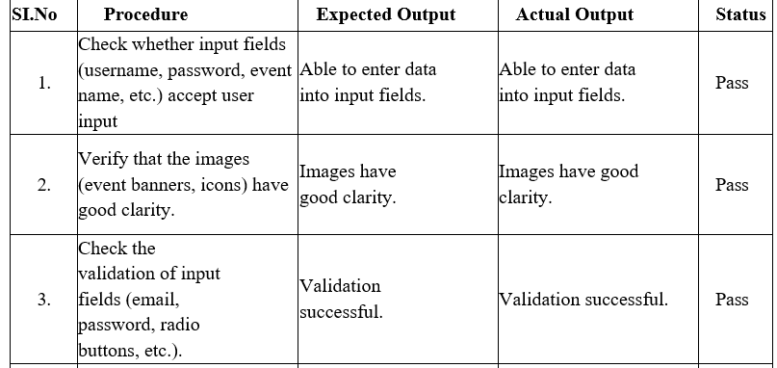
GUI TEST CASES

Slide 76
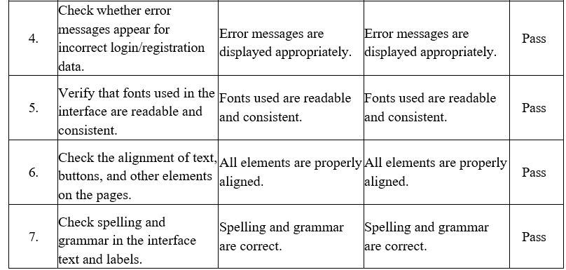
GUI TEST CASES

Slide 77
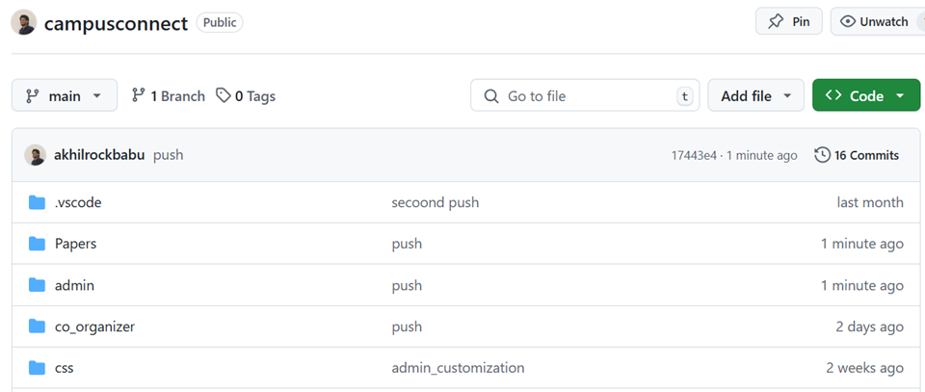
GIT HISTORY

Slide 78
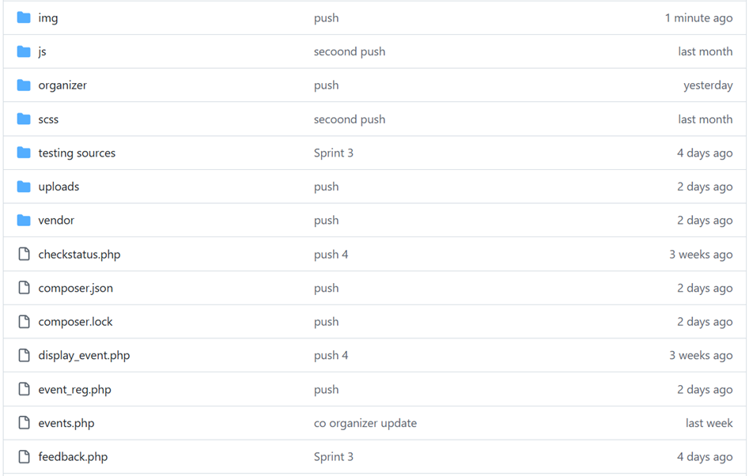
GIT HISTORY

Slide 79

GIT HISTORY

Slide 80
FUTURE WORKS
AI-DRIVEN EVENT RECOMMENDATIONS
BLOCKCHAIN-BASED CERTIFICATE GENERATION AND VERIFICATION
ADVANCED ANALYTICS DASHBOARD FOR ORGANIZERS AND ADMINS

Slide 81
REFERENCES
1. J. R. V. Jeny, P. Sadhana, B. J. Kumar, S. L. Abhishek and T. Sai Chander, "A Web based-College Event Management System and Notification Sender," 2022 4th International Conference on Inventive Research in Computing Applications (ICIRCA), Coimbatore, India, 2022, pp. 1434-1438, doi: 10.1109/ICIRCA54612.2022.9985774.
2. R. F. Olanrewaju, B. U. I. Khan, M. A. Morshidi, F. Anwar and M. L. B. M. Kiah, "A Frictionless and Secure User Authentication in Web-Based Premium Applications," in IEEE Access, vol. 9, pp. 129240-129255, 2021, doi: 10.1109/ACCESS.2021.3110310.
3. K. T. Fathimath Hanan, T. Henna Sherin, U. Lulu Shadin, K. C. Dilshad and A. P. Sulthana Rinsy, "Streamlined Application for Managing College Events," 2024 International Conference on Innovations and Challenges in Emerging Technologies (ICICET), Nagpur, India, 2024, pp. 1-6, doi: 10.1109/ICICET59348.2024.10616323..
4. PHP Official Documentation - https://www.php.net/manual/en/
5. MongoDB with PHP Official Documentation - https://www.mongodb.com/docs/languages/php/

Slide 82
RELEVANCE
By automating processes like participant registration, event tracking, and report generation, the system saves time and reduces administrative burdens
Its customizable templates and registration forms make it adaptable to the unique needs of various institutions
Additionally, the system allows events to be promoted through a dedicated website, helping attract a larger number of participants

Slide 83

THANK YOU

